Slide 1
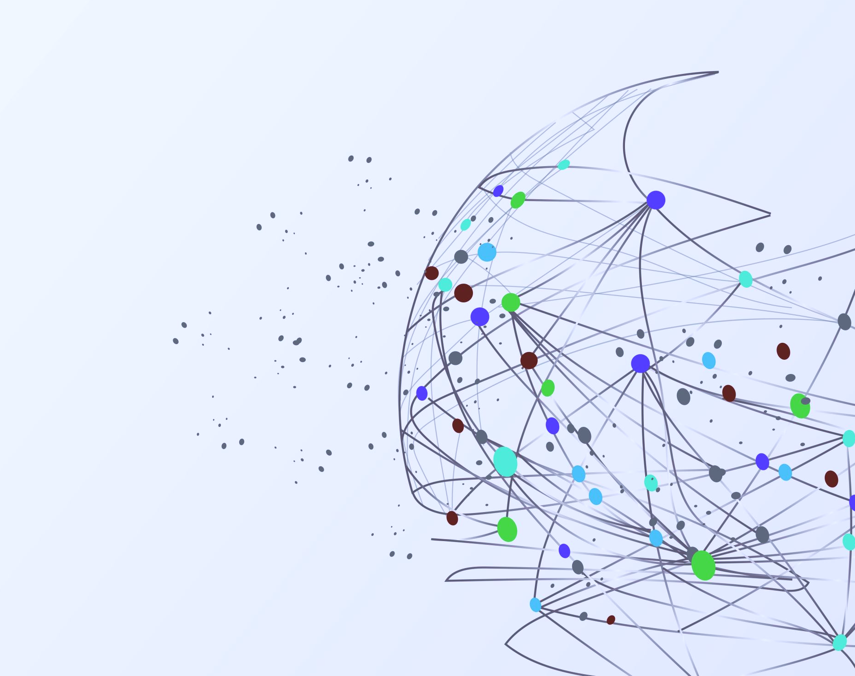
Project Deliverable - 2 Physical Activity Prediction using wearable device data
Group - 17
Gautam Vanishree Raghu
Krishen Jagani
Yile Xu
Waasi Ahmed Jagirdar
Jason Misquitta

Slide 2
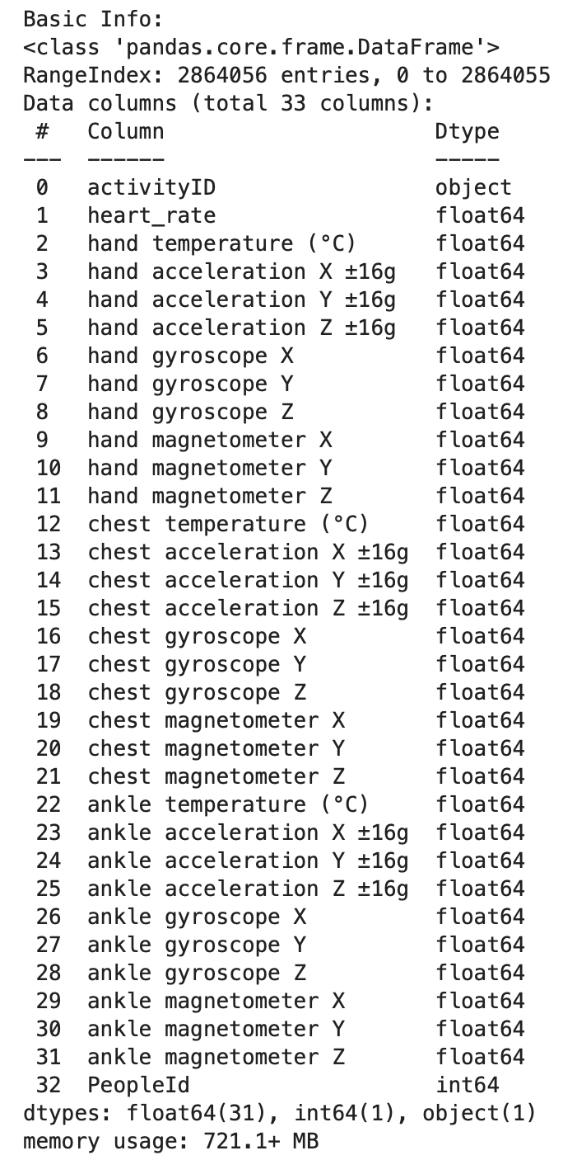
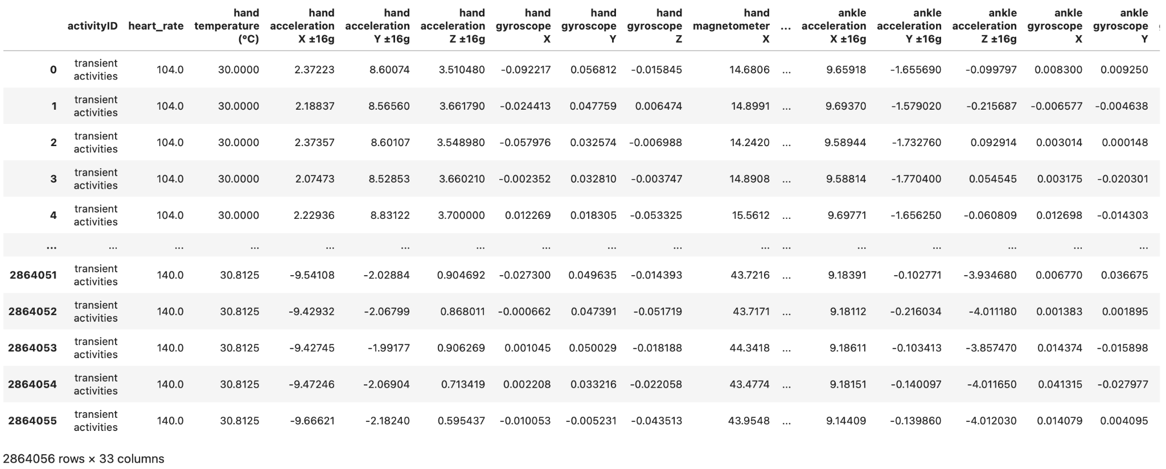
Dataset Overview
Dataset : PAMAP2 - Physical Activity Monitoring https://archive.ics.uci.edu/dataset/231/pamap2+physical+activity+monitoring
The dataset contains 2864056 observations, 18 different physical activities (walking, cycling, playing soccer, etc.) as the target, 32 different physical activity monitoring metrics as the its features

Slide 3
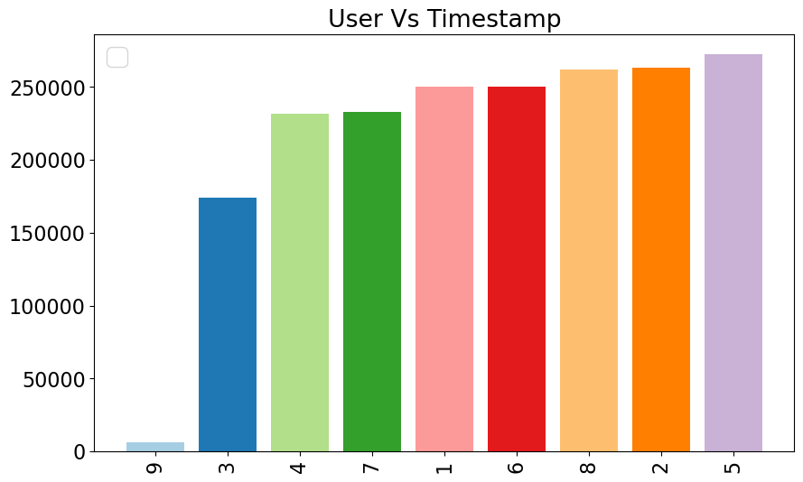
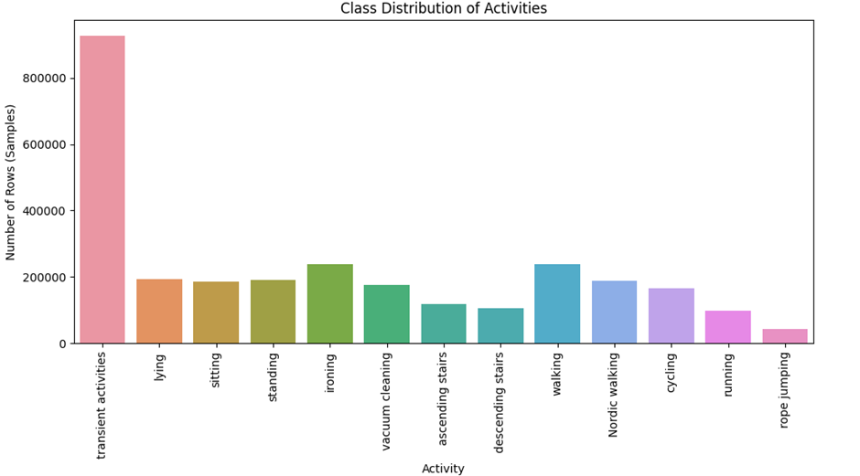
Dataset Exploration
Dataset : PAMAP2 - Physical Activity Monitoring https://archive.ics.uci.edu/dataset/231/pamap2+physical+activity+monitoring
The dataset contains data of 18 different physical activities (walking, cycling, playing soccer, etc.), performed by 9 subjects (101 - 109) wearing 3 inertial measurement units and a heart rate monitor.
Subject 109 has the least number of data points, so it can be removed as it might affect the result.
Similarly, we find the number of data points across each activity. It is clear and normal to see that rope jumping is the least performed activity.

Slide 4
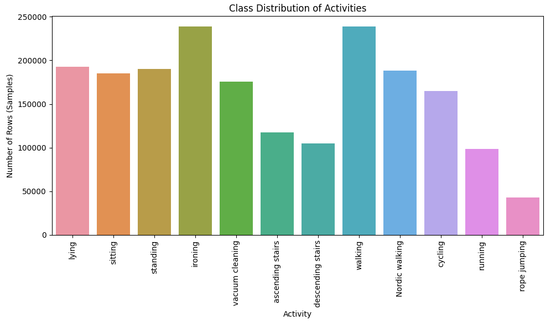
Data Cleaning and Sampling
As per the dataset protocol readme, activityID : 0 (transient activity) must be removed completely from our dataset since this is transient period where the subject was not doing any particular activity. (Noise)
It is also evident that there were some wireless disconnections in data collection therefore the missing data has to be accounted for and made up in a way that our data analysis will not be impacted
To account for the missing data, we perform data imputation by using interpolation on the data after removing the noisy data.

Slide 5
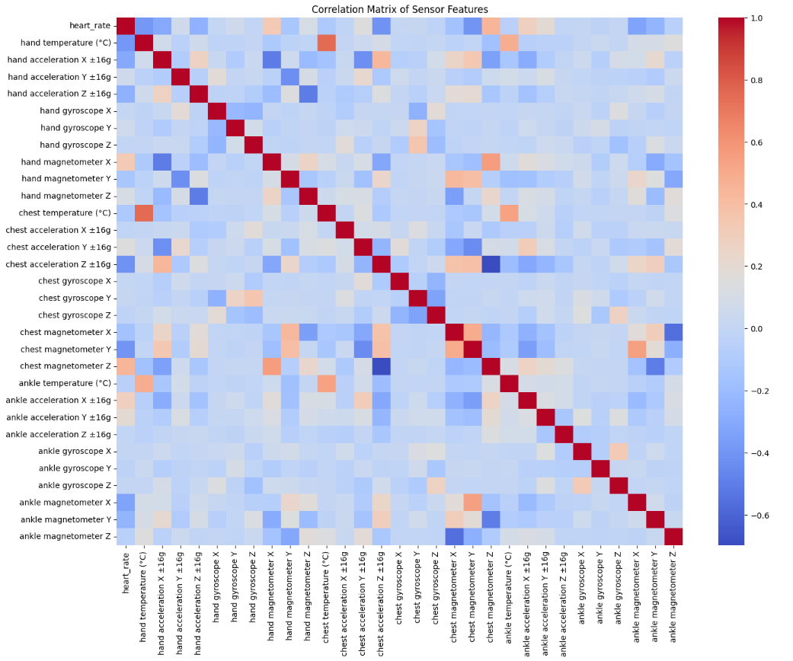
Correlation among features
The correlation heatmap shows strong correlations between (chest temperature and hand temperature), (ankle temperature and chest temperature), (ankle magnetometer reading and chest magnetometer reading) and (chest magnetometer Z reading and chest acceleration Z reading.
This correlation opens the possibility for trying out dimensionality reduction techniques such as Principal Component Analysis (PCA) to simplify the dataset without losing too much information.

Slide 6
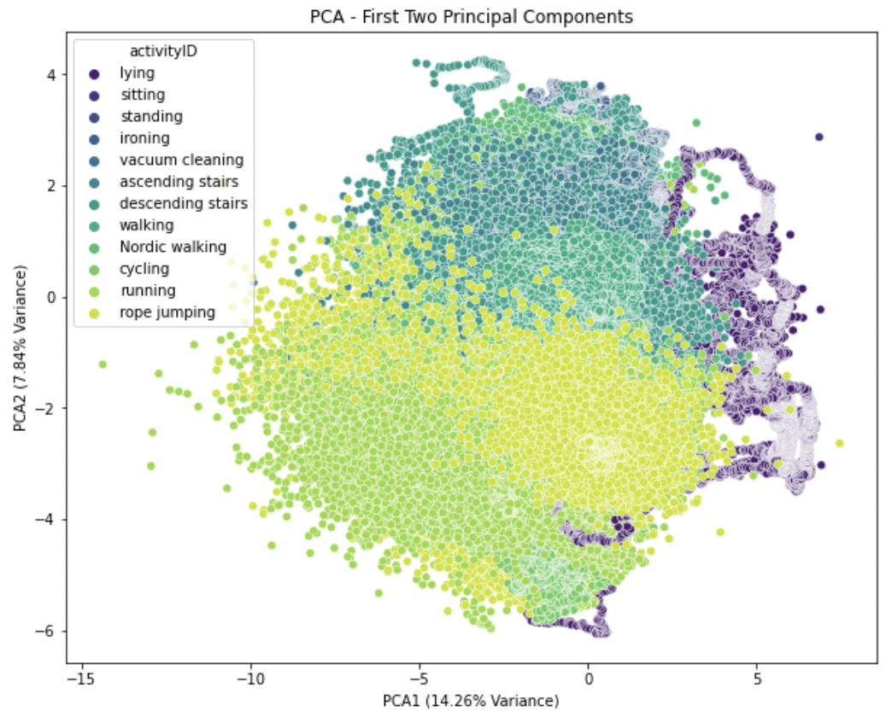
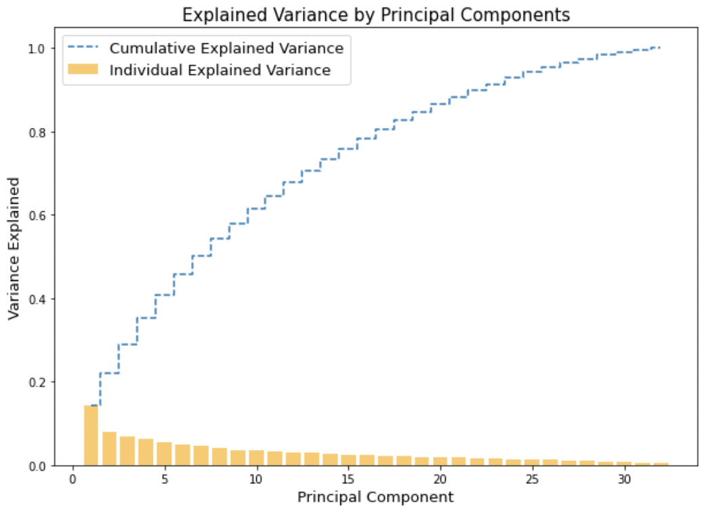
Principal Component Analysis (PCA)
Since the dataset is quite complex with 32 features and 12 classes for the target variable, the first two principal components from the Principal Component Analysis (PCA) analysis only explained 22.07% of the variance in the data.
The visualization of them also shows that these two principal components are unable to separate each class.

Slide 7
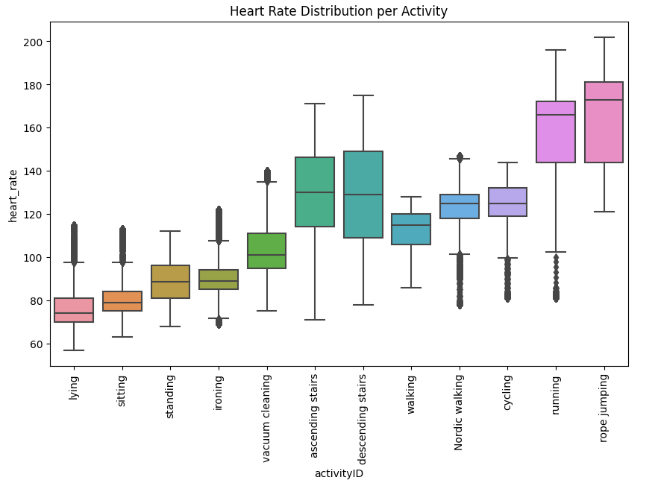
Feature distribution across activities (Heart Rate)
The distinct distribution between patterns for heart rate across different activities suggests that heart rate is a strong feature for differentiating activity types. High cardiovascular activities can likely be identified based on high heart rate only.

Slide 8
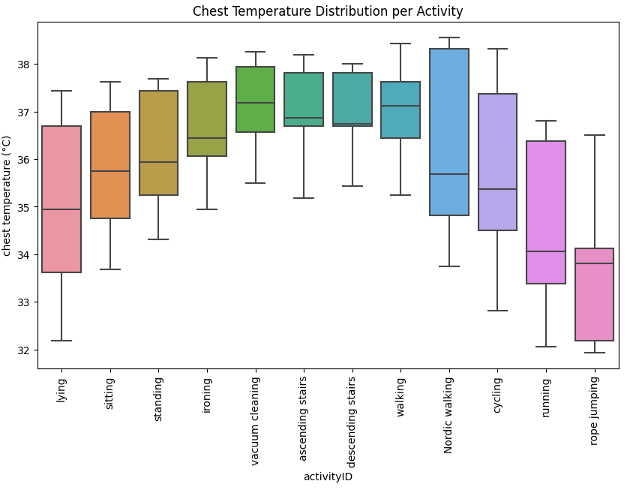
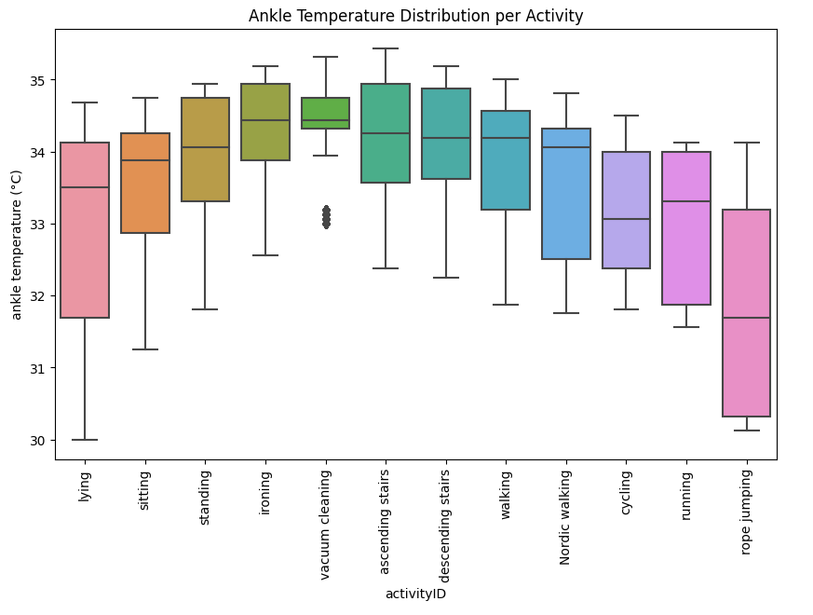
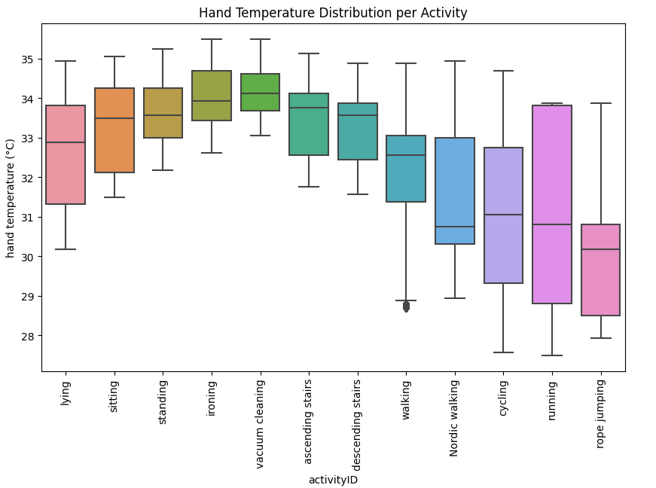
Feature distribution across activities
Lower hand and chest temperatures in high-intensity activities suggest cooling effects that could help differentiate activity intensity.

Slide 9

Modelling techniques to be used
Since this is a multiclass classification problem with over 33 features, we will be using the below ML algorithms to predict the different classes:
Logistic Regression
Decision Trees
Random Forests
Support Vector Machines
Deep Neural Networks
We’ll also be following the below techniques in modelling the ML algorithms:
Gradient Boosting
Bagging
Model Ensembling
Cross Validation (Grid Search/ Random Search)
AutoML

Slide 10
Modelling techniques to be used
Logistic Regression: Logistic Regression is a simple model that serves as a great starting point for our classification problem. It allows us to set the baseline for comparison with more complex models.
Decision Trees: For our activity prediction problem Decision Trees are helpful because they would help in capturing non-linear relationships and allowing us to distinguish between sets of activities.
Random Forests: Random forests are ensembles of multiple decision trees which makes the prediction of our data more stable, accurate, and robust than a single tree.
Support Vector Machines: As Support Vector Machines are well suited for handling high dimensional data by generating complex decision boundaries by utilizing kernel functions, This applies to our problem as well, since our data has a large number of features.
Deep Neural Networks: Deep Neural Networks can learn complex patterns within a dataset. For our dataset, they are ideal as they can capture non-linear relationships between the sensor data and hence improve accuracy.

Slide 11
Other techniques to be followed in modelling the ML algorithms
Gradient Boosting
Bagging
Model Ensembling
Cross Validation (Grid Search/ Random Search)
AutoML

